Slide 1

IBM CAPSTONE PROJECT
ACCIDENT-SEVERITY MODEL PRESENTATION

Slide 2

Introduction | Business Undertanding
There is a huge impact on the society due to traffic accidents where there is a great costs of fatalities and injuries. In recent years, there is a increase in the researches attention to determine the significantly affect the severity of the drivers injuries which is caused due to the road accidents. Accurate and comprehensive accident records are the basis of accident analysis. the effective use of accident records depends on some factors, like the accuracy of the data, record retention, and data analysis. There is many approaches applied to this scenario to study this problem

Slide 3
Data Understanding
Our predictor or target variable will be 'SEVERITYCODE' because it is used measure the severity of an accident from 0 to 5 within the dataset. Attributes used to weigh the severity of an accident are 'Latitude', 'longitude' and 'time'.
Severity codes are as follows:
• 0:Little to no Probability (Clear Conditions)
• 1 : Very Low Probablility - Chance or Property Damage
• 2 : Low Probability - Chance of Injury
• 3 : Mild Probability - Chance of Serious Injury
• 4 : High Probability - Chance of Fatality

Slide 4

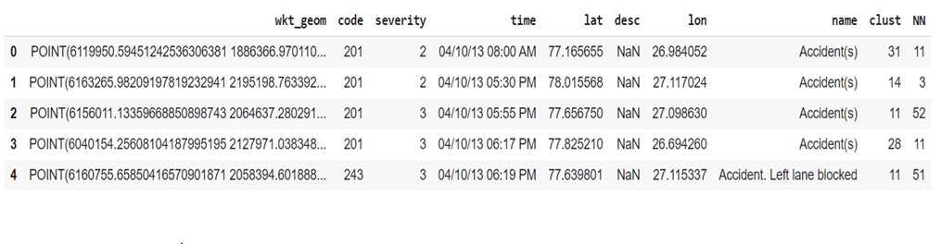
Extract Dataset & Convert
In it's original form, this data is not fit for analysis. For one, there are many columns that we will not use for this model. Also, most of the features are of type object, when they should be numerical type.

Slide 5
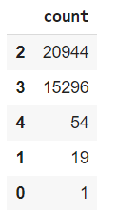
Balancing the Dataset
Our target variable SEVERITYCODE is unbalaced . In fact, severitycode in class 4,1,0 is nearly negligible as compare to 2 and 3.
We can fix this by downsampling the minority class

Slide 6
Preprocessing, covert the time format to months, weekdays, years, hours
1. df["month"] = df["time"].apply(lambda x:int(x[:2]))
2. df["day"] = df["time"].apply(lambda x:int(x[3:5]))
3. df["year"] = df["time"].apply(lambda x:int(x[6:8]))
4. df["hour"] = df["time"].apply(lambda x: int(x[9:11]) if str(x)[15] == 'A' else 12 + int(x[9:11]) )
5. df["lon"] = df["lon"].apply(lambda x:abs(x)) #so that multinomialNB works (only with positive features)
6. #creating the date at the datetime format (easier to deal with)
7. df[ "date" ]= df[["month" , "day" ,"year"]].apply(lambda x:pd.datetime(month = x['month'] , day = x['day'] , year = 2000+x["year"]), axis = 1)

Slide 7
Applying Cross Validation and Splitting the data into training set and test sets , ratio of 2:8
from sklearn.cross_validation import train_test_split
X_train, X_test, y_train, y_test = train_test_split(X, y, test_size=0.20, random_state=42)

Slide 8

Methodology
K-Nearest Neighbor (KNN)
KNN will help us predict the severity code of an outcome by finding the most similar to data point within k distance.
Decision Tree
A decision tree model gives us a layout of all possible outcomes so we can fully analyze the concequences of a decision. It context, the decision tree observes all possible outcomes of different weather conditions.
Logistic Regression
Because our dataset only provides us with two severity code outcomes, our model will only predict one of those two classes. This makes our data binary, which is perfect to use with logistic regression.

Slide 9
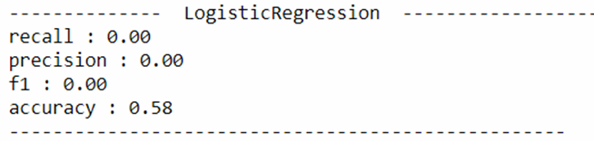
Because our dataset only provides us with two severity code outcomes, our model will only predict one of those two classes. This makes our data binary, which is perfect to use with logistic regression.
Logistic Regression
1. #logreg (it predicts everything to 0, the most common class)
2. # a predictive analysis , where we comapre a relation between binary varaible
3. # and other ordinal and nominal and indepdendent variables
4. #also here we are not using any paramneter's
5. #use from training set and test sets
6. #for cross valiadtion
7.
8.
9. from sklearn.linear_model import LogisticRegression
10. clf = LogisticRegression()
11. clf.fit(X_train,y_train)
12. y_pred = pd.Series(clf.predict(X_test))
13. printScores(y_test, y_pred, "LogisticRegression")

Slide 10
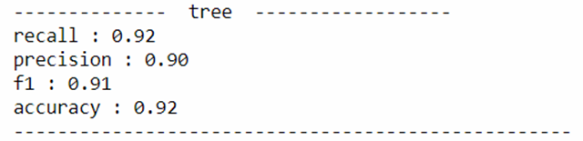
Tree Algorithm
1. #tree
2.
3. #structured tree where it containts root nodes , leaf node
4. #each brach of the tre depicts outcome of the tree
5.
6. # use from training set and test sets
7. #for cross valiadtion
8.
9. from sklearn import tree
10. clf = tree.DecisionTreeClassifier()
11. clf.fit(X_train,y_train)
12. y_pred = clf.predict(X_test)
13. printScores(y_test, y_pred, "tree")

Slide 11
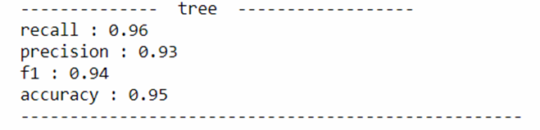
Tree algorithm (modified training set)
1. #tree
2. #MODIFIED TRAINING SET of lat and longitude
3. #this one is parametrized
4. # use from training set and test sets , only 2 variables , lat and lon
5. #for cross validation
6.
7. X_train2 , X_test2 = X_train[["lat" , "lon" ]] , X_test[["lat" , "lon" ]]
8. from sklearn import tree
9. clf = tree.DecisionTreeClassifier()
10. clf.fit(X_train2,y_train)
11. y_pred = clf.predict(X_test2)
12. printScores(y_test, y_pred, "tree")

Slide 12
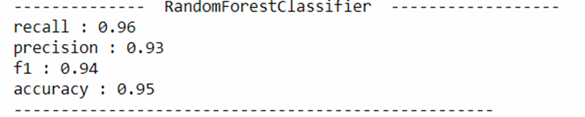
Random Forest Algorithm (modified training set)
1. #random forest
2.
3. # use from training set and test sets
4. # for cross valiadtion
5. #n_estiamotor is 100 , as default from update of 2.10
6.
7.
8. from sklearn.ensemble import RandomForestClassifier
9. clf = RandomForestClassifier(n_estimators = 100)
10. clf.fit(X_train2,y_train)
11. y_pred = clf.predict(X_test2)
12. printScores(y_test, y_pred, "RandomForestClassifier")

Slide 13
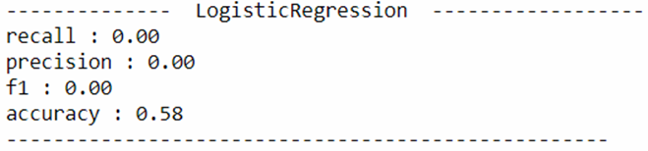
Logistic Regression (Modified training Set)
1. #logreg (it predicts everything to 0, the most common class)
2.
3. # use from training set and test sets
4. #for cross valiadtion
5.
6. from sklearn.linear_model import LogisticRegression
7. clf = LogisticRegression()
8. clf.fit(X_train2,y_train)
9. y_pred = pd.Series(clf.predict(X_test2))
10. printScores(y_test, y_pred, "LogisticRegression")

Slide 14
Training set graph prediction
1. #drawing the prediction graph
2. training_set_size = [0.05*i for i in range(1,19)]
4. accuracy = []
5. from sklearn import tree
6. for size in training_set_size:
7. # won't be using the test in that case...this is just a way of splitting the data
8. X_train2, X_test2, y_train2, y_test2 = train_test_split(X_train, y_train, test_size=1-size, random_state=42)
9. clf = tree.DecisionTreeClassifier()
10. clf.fit(X_train2,y_train2)
11. y_pred = clf.predict(X_test)
12. #printScores(y_test, y_pred, "tree")
13. accuracy.append( (X_train2.shape[0] ,accuracy_score(y_test, y_pred) ) )
14. xx = [w[0] for w in accuracy]
16. yy = [w[1] for w in accuracy]
17. plt.scatter(xx,yy)
18. plt.xlabel('Training Set Size')
19. plt.ylabel('Accuracy')
20. plt.title("Learning Curve: Accuracy vs training set size")
21. plt.tight_layout()

Slide 15
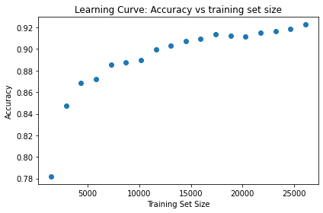
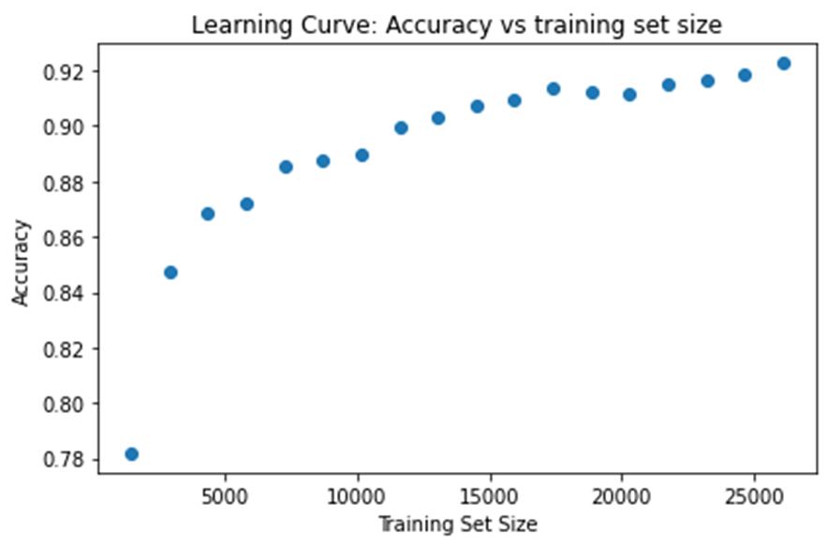

Slide 16
Result and Evaluation
Now we will check the accuracy of our models.
By evaluating all models , tree model have the highest accuracy among all.
Discussion
In the beginning of this notebook, we had categorical data that was of type 'object'. This is not a data type that we could have fed through an algoritim, so label encoding was used to created new classes that were of type int8; a numerical data type.
After solving that issue we were presented with another - imbalanced data. As mentioned earlier, class 1,0,4 are very less as compare to 2,3. The solution to this was downsampling the minority class with sklearn's resample tool. We downsampled to match the match the class and finally created our model with only two predicted variable 2,3.

